Slide 1
Designing a business platform using Microservices
Rajendra Kharbuja, Master Thesis - Initial Presentation

Slide 2
Outline
Background Context
Research question
Current status
Next steps

Slide 3
Outline
Background Context
Research questions
Current status
Next steps

Slide 4
Context
Monolith Architecture Style
Definition
application deployed as a single artifact irrespective of internal structure [1][2]
One of three cases:[3]
All code share the same codebase and need to be compiled together
All deployment share same versioned code
The whole application is run under single server process
References
C. Richardson. Microservices: Decomposing Applications for Deployability and Scalability. May 2014
C. Richardson. Pattern: Monolithic Architecture. 2014. url: http://microservices.io/patterns/monolithic.html
R. Annett. What is a Monolith? Nov. 2014

Slide 5
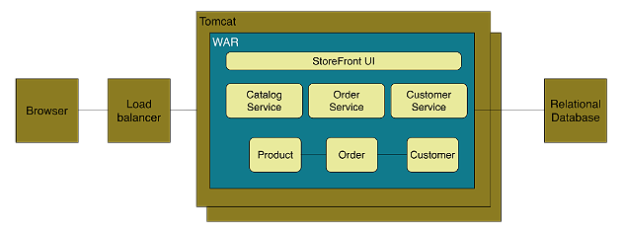
Context
Monolith Architecture Style
Example
Figure: Online Store Example of Monolith Architecture [1]
References
C. Richardson. Microservices: Decomposing Applications for Deployability and Scalability. May 2014

Slide 6
Context
Monolith Architecture Style
Advantages [1-4]
Disadvantages [1, 3-5]
Easy to develop and test
Deployment is easy
Scaling is clear and simple
Prompt reuse of functionalities
Limited Agility
Decrease in Productivity
Difficult Team Structure
Long-term Commitment to
Technology Stack
Limited Scalability
References
C. Richardson. Pattern: Monolithic Architecture. 2014. url: http://microservices.io/patterns/monolithic.html
M. Fowler and J. Lewis. Microservices. Mar. 2014. url: http://martinfowler.com/articles/microservices.html
Gupta. Microservices, Monoliths, and NoOps. Mar. 2015
S. Abram. Microservices. Oct. 2014. url: http://www.javacodegeeks.com2014/10/microservices.html
D. Namiot and M. Sneps-Sneppe. On Micro-services Architecture. Tech. rep.Open Information Technologies Lab, Lomonosov Moscow State University,2014
S. Newman. Building Microservices. O’Reilly Media, 2015

Slide 7
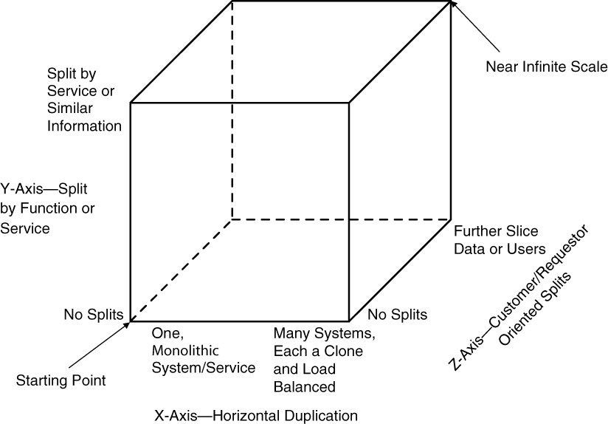
Context
Scale Cube
Dimensions
X-axis | Horizontal Cloning
Z-axis | Split by Criteria
Y-axis | Split by Function / Data
Figure: Scale Cube [1]
References
M. T. Fisher and M. L. Abbott. The Art of Scalability: Scalable Web Architecture,Processes, and Organizations for the Modern Enterprise, Second Edition.Addison-Wesley Professional, 2015

Slide 8
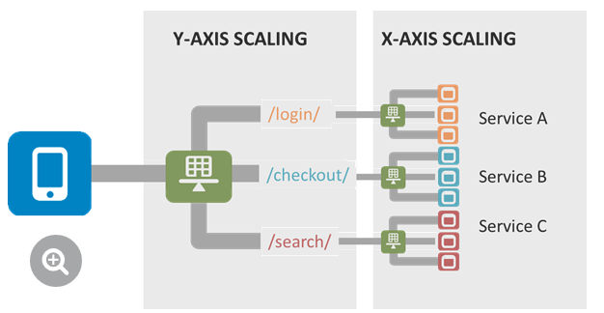
Context
Scale Cube
Figure: Example Application of Scale Cube [1-3]
References
L. MacVittie. The Art of Scale: Microservices, The Scale Cube and Load Balancing.Nov. 2014
C. Richardson. Pattern: Microservices Architecture. 2014
C. Richardson. Microservices: Decomposing Applications for Deployability and Scalability. May 2014

Slide 9
Background and motivation
Problem statement
Siemens internal software architecture definition and management department is in charge of
In-house consulting
Consulting
Knowledge need
Knowledge sources
Literature
Intranet
Expertise
Minds of architects
Requires knowlegde about software architecture methods
Software Architects are involved in internal- and research projects
Gather new expertise and experiences through projects
Code / Architecture reviews
Guidelines for development
IT-Project management
Research
EU sponsored projects
Cooperation with academic institutes
Internal projects for improvements & innovations
Problems
No central knowledge (method) source for architecture methods
No assessment of known methods
No IT supported recommendation mechanism for method selection

Slide 10

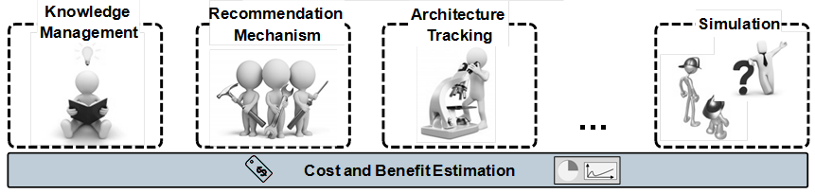
Background and motivation
AMELIE - The architecture management workbench
Siemens started an internal project to develop an architecture management toolbox which supports software architects in their daily work.
AMELIE
AMELIE = Architecture Management Enabler for Leading Industrial softwarE
Objectives of AMELIE
Guide architects to perform architecture management.
Ensure that software architecture, business strategy and innovation go hand in hand.
Be “in control” of architecture development and “in sync” with the business.
Foster experience sharing inside Siemens
AMELIE ecosystem
Value added services of AMELIE

Slide 11
Background and motivation
AMELIE - The architecture management workbench
User Stories (US) describing the scope of the AMELIE workbench
US-01: Step-wise guidance for executing SW-Development project
US-04: “Real” instantiation of method / artefact
US-02: Provide list of recommended methods
US-03:
Best practice recommendation
US-05: Reference to an expert

Slide 12
Background and motivation
Practical context / Examples for software architecture methods
Terms & relations
Facet
is like a development step (e.g. Business Case, Requirements Elicitation), which is passed through architecture development.
Topic
is like a category (e.g. Situation Analysis) which contains several architecture methods to realise the topic specific objectives.
Architecture method
is a method (e.g. 5C Business Analysis ) to achieve objectives of a topic
Facet
*
*
Topic
*
*
Architecture Method
Example: 5C Business Analysis
Belongs to topic Situation Analysis which is part of the facet Business Case.
Focuses on the business environment of the product
It covers collaborators, customers, competitors, own company resources as well as the context of the current technology available in the market.
Results are e.g. roadmaps, business cases and decisions on possible solution variants.
My tasks
Structuring of methods and context information
Development of a recommendation mechanism for software architecture methods

Slide 13
Outline
Background and motivation
Research question & roadmap
Current state
Next steps

Slide 14
Research question & roadmap
How should a recommender system be designed in order to be appropriate for knowledge management of software architecture methods as well as for active recommendation during the development process?
Progress
March / Mai
1) Literature review
Recommender systems
2) Recommendation method/concept identification
Deliverable: Appropriate recommendation method
3) Method instantiation
in general and for software architecture methods
Deliverable: Literature classification scheme
Analysis of development process at Siemens
Method selection, based on existent process and literature
Concept development for recommendation system
Method instantiation (prototype) and qualitative evaluation
Deliverable: Evaluated concept and prototype
4) Writing + buffer time
Detailed writing & correction
Deliverable: Final thesis
Submission date 15.09.2015
June
June / July
August / September

Slide 15
Outline
Background and motivation
Research question & roadmap
Current state
Next steps

Slide 16
Current state
Step 1 - Literature review
Objectives
Gather information about concepts for recommender systems
Establish understanding for concepts its functionalities and characteristics
Create classification scheme to get a overview of most relevant articles
Research concept
Search terms
Determination of search terms by means of initial research and existing literature reviews
Collaborative ﬁltering / Contents ﬁltering / Personalization system / Recommendation system Recommendation platform / Recommender system / Preference systems
Databases
Several areas are involved: Information retrieval / Forecast theories / Marketing …
Five databases of EBSCO / Science Direct / Google Scholar
Analyse steps
Title & Abstract screening, Number of citations ➔potentially relevant (Y/N)
Available (Y/N)
Analysis of article content, for- / backward search ➔ relevant (Y/N)
Classification of article
Source(s): (Armstrong, 2001 / Lilien, Kotler & Moorthy, 1992 / Park, Kim, Choi & Kim / 2012; Salton, 1989)

Slide 17
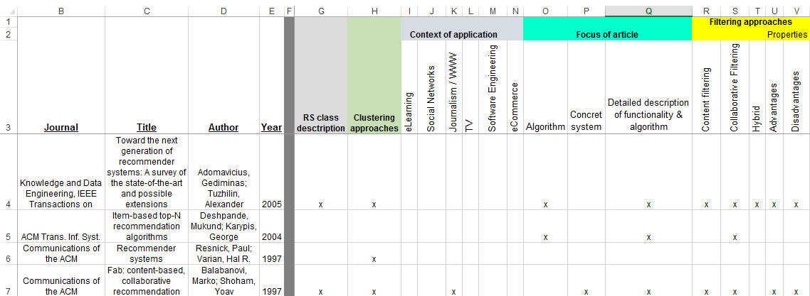
Current state
Step 1 - Literature review
Classification scheme
Structure of classification scheme was built up based on the abstracts of potentially relevant articles. Refinement was performed while reading.
Most relevant content of the articles is described in my thesis
Source: Classification scheme (extract)
Added value
Structured overview of most relevant articles
Possibility to find articles very easy regarding a certain topic

Slide 18
Current state
Step 1 - Literature review
Some knowledge for further actions - recommender / filtering approaches
We need profiles of elements and/or users. Profiles include a kind of preference or item evaluation which is used to generate useful recommendation.
Content recommendations
User will be recommended items similar to the ones the user preferred in the past.
Collaborative recommendations
The user will be recommended items that people with similar tastes and preferences liked in the past.
The utility of an unseen item is calculated based on passive or active feedback which is stored in profiles.
Hybrid approaches
Combines elements of both collaborative and content-based methods.
Source(s): (Adomavicius & Tuzhilin, 2005 / Pazzani & Billsus, 1997 / Raymond J. & Loriene, 2000)

Slide 19
Outline
Background and motivation
Research question & roadmap
Current state
Next steps

Slide 20
Next steps
Methodology for further action
Design science (DS)
Action design research (ADR)
DS is captured in the “build and then evaluate” cycle
Focus on building artefacts and relegate evaluation to a subsequent & separate phase
Scant attention to the shaping of IT artefacts by the organizational context
Fails that the artefacts emerges from interaction with the organization
➔Need for a research method that explicitly recognizes artefacts as emerging from design, use and ongoing refinement in context.
Reflects the premise that IT artefacts are ensembles shaped by the organizational context during development and use
Building and evaluating artefacts goes hand in hand
Various forms of the organizational context can be inscribed into the artefact during its development and use.
Provides guidance for combining building, intervention and evaluation
Added value
Design, use and ongoing refinement in context
Methodology focuses practical use of artefact as well as a scientific approach
Notes:
Design Science Research (Hevner 2004)
IT artifacts are broadly defined as constructs (vocabulary and symbols),
models (abstractions and representations),
methods (algorithms and practices), and
instantiations (implemented and prototype systems).
DR is captured in the “build and then evaluate” cycle proposed by March and Smith (1995) and advocated by Nunamaker et al. (1991) and Hevner et al. (2004).
In addition, although current DR methods are strong in their support of abstraction and invention, they consider organizational intervention to be secondary (Cole et al. 2005).
To explicitly account for such interventions, and thus expand and enhance the DR approach, we turn to a research approach that has organizational intervention at its very heart, namely AR.
Action Research
AR combines theory generation with researcher intervention to solve immediate organizational problems (Baburoglu and Ravn 1992; Baskerville and Wood-Harper 1998). Thus, AR aims to link theory with practice, and thinking with going (Susman 1983). It is typically an iterative process based on working hypotheses refined over repeated cycles of inquiry(Davison et al. 2004; Susman and Evered 1978).
Action Design Research
ADR is a research method for generating prescriptive design knowledge through building and evaluating ensemble IT artifacts in an organizational setting
It deals with two seemingly disparate challenges: (1) addressing a problem situation encountered in a specific organizational setting by intervening and evaluating; and (2) constructing and evaluating an IT artifact that addresses the class of problems typified by the encountered situation. The responses demanded by these two challenges result in a method that focuses on the building, intervention, and evaluation of an artifact that reflects not only the theoretical precursors and intent of the researchers but also the influence of users and ongoing use in context.

Slide 21
Next steps
Completion of literature review
Further analysis of internal development process
Definition of data model for structuring architecture methods
Development of recommendation concept
Instantiation and final evaluation of concept (proof of concept/prototype)

Slide 22

Thank you for your attention!
Any questions?

Slide 23
Bibliography
Adomavicius, G. & Tuzhilin, A. (2005). Toward the next generation of recommender systems: A survey of the state-of-the-art and possible extensions. Knowledge and Data Engineering, IEEE Transactions on, 17 (6), 734–749.
Armstrong, J. S. (2001). Principles of forecasting: A handbook for researchers and practitioners. Boston, MA: Kluwer Academic.
Hevner, A. R., March, S. T., Park, J., & Ram, S. (2004). Design science in information systems research. MIS Q, 28(1), 75–105.
Lilien, G. L., Kotler, P. & Moorthy, K. S. (1992). Marketing models. Prentice-Hall Englewood Cliﬀs, NJ.
Park, D. H., Kim, H. K., Choi, I. Y. & Kim, J. K. (2012). A literature review and classiﬁcation of recommender systems research. Expert Systems with Applications, 39 (11), 10059–10072. Access to http://www.sciencedirect.com/science/article/pii/S0957417412002825doi: 10.1016/j.eswa.2012.02.038
Pazzani, M. & Billsus, D. (1997). Learning and revising user proﬁles: The identiﬁcation of interesting web sites. Machine learning, 27 (3), 313–331.
Raymond J., M. & Loriene, R. (2000). Content-based book recommending using learning for text categorization. In Proceedings of the ﬁfth acm conference on digital libraries (S. 195–204). San Antonio, Texas, USA: ACM. doi: 10.1145/336597.336662
Salton, Gerard. (1989). Automatic text processing: the transformation, analysis, and retrieval of information by computer. Addison-Wesley Longman Publishing Co.,Inc.
Sein, M. K., Henfridsson, O., Purao, S., Rossi, M., & Lindgren, R. (2011). Action design research. MIS Q, 35(1), 37–56.

Slide 24
Backup - Current state
Literature review
Research concept
Search terms
Determination of search terms by means of initial research and existing literature reviews (Park, Kim, Choi & Kim, 2012, P. 10060).
Collaborative ﬁltering / Contents ﬁltering / Personalization system / Recommendation system Recommendation platform / Recommendation engine / Recommender system / Preference systems
Databases
EBSCO Business Source Premier / EBSCO EconLit / EBSCO Education Source / EBSCO ERIC / EBSCO Library, Information Science & Technology Abstracts / Science Direct /Google Scholar
Criteria (Initial Search):
Must haves
Publication in academic journal
Publication date between 01.01.2000 and 31.03.2015 (Park, Kim, Choi & Kim, 2012, P. 10060);
Article must contain at least one of the search terms
Exclusion criteria
Dissertations, unpublished working papers, textbooks, newspaper articles
Article is not completely in English or German
Article is not for free with TUM access rights
Source: (Park, Kim, Choi & Kim, 2012, P. 10060)

Slide 25
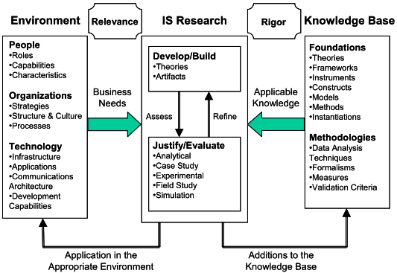
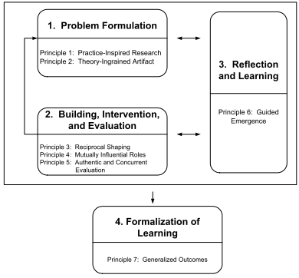
Backup - Research methodology
Design science vs. action design research
DS in IS research - framework
ADR method: stages and principles
Source: (Hevner, March, Park, & Ram, 2004)
Source: (Sein, Henfridsson, Purao, Rossi, & Lindgren, 2011)

Slide 26
Backup – Next steps
Characteristics of the prototype
Prototype
Objectives of prototype
Proof of concept
Demonstration of the concept, data model
Demonstration of rudimental assessment and recommendation functionalities
Evaluation of functionality and determination of future improvements
Not objectives of prototype
Administration of content or users
Technology
JAVA
User Interactions
By means of console input/output
Source: (Park, Kim, Choi & Kim, 2012, P. 10060)

